Slide 1
Timeless Veterinary Systems Training
A user guide on how cases are submitted and
Completed through the Timeless Platform

Slide 2
Agenda
How to access the Timeless Portal
Review clinics case submission workflow
Case worklist and assigned cases
Cases marked as “Requiring action”
Navigation menu items

Slide 3
The first step in submitting a referral case through the Timeless System is to go to the following web site address, https://timelessveterinary.community/landing/MVS Click on the Log In option in the top right corner of the page, this will take you to a log in screen where you can enter your email address and password.
Accessing the Timeless Portal

Slide 4
If this is your first time logging in, you will be prompted to accept the Terms and Conditions of use. You will need to review the document first before being able to click the accept button. Once logged in you will see the “Welcome” page, which contains your navigation menu on the left-hand side and the main page which displays information for the currently selected page. To get started with submitting a case use the “Create New Case” button located on the right side of the page.
Clinic case submission

Slide 5
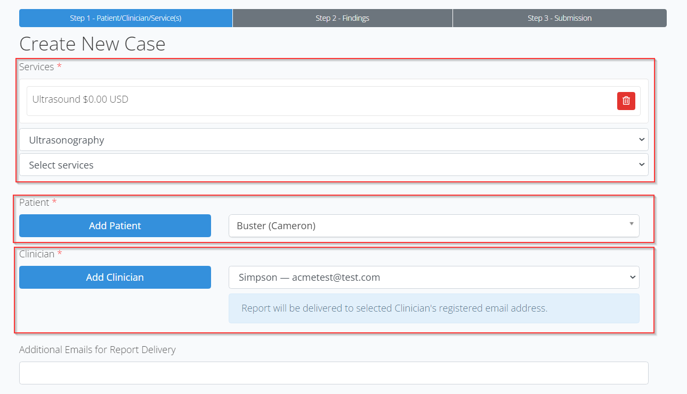
As the first step the referring veterinarian will need to select a service from the drop down, select an existing patient from the list or add a new patient record, and then select the clinician requesting the service. Fields marked with a red asterisks are required and must be filled out before clicking the submit button. If additional doctors wish to receive a copy of the report, then they can enter these emails in the field provided at the bottom of the form. If the submitting clinician is not listed, use the “Add Clinician” button to create the new user and they will then be available to select from the drop-down meu.
Clinic case submission

Slide 6
Clinics will need to complete the Clinical Findings form with requested data. All fields marked with a red asterisks must be completed before clicking on “Save & Continue”. *Please do not add images to the text boxes on this step, you can add attachments in Step 3 of the case creation process.
Clinic case submission

Slide 7
If there are any lab results, documents or images, that the submitting clinician would like to include, they can do so at this point by using the “Attachments” section. They will need to click on the “Add Attachments” button, which will bring them to a screen where they can either drag and drop the files into the provided box or click on the box and a find files/folder box will appear. They can navigate to where the files are located on the computer and select them that way. Once the files have been added you can then click the blue “Back” button to return to the case.
Clinic case
submission

Slide 8
Once all the details have been completed for the case, the clinician can click the “Submit Case” button at the top of the page to complete the request. Once submitted, they will be returned to the case worklist page where they can see the new case with a status of “Submitted”. When the Specialist has completed your report, you will be notified via email that it is completed, and a PDF of that report will be attached to that email.
Clinic case submission

Slide 9
Occasionally a case will be marked as “Requiring action”, when this happens a message should be sent via email as well as show in the comments section at the bottom of the case indicating a case requires an action to be taken. The case itself will show in your cases requiring action tab and will be marked in orange as “Requires Action”.
Cases Marked as
Requiring action

Slide 10
Occasionally a case will be marked as “Requiring action”, when this happens a message should be sent via email as well as show in the comments section at the bottom of the case indicating a case requires an action to be taken. The case itself will show in your cases requiring action tab and will be marked in orange as “Requires Action”.
Cases Marked as
Requiring action

Slide 11
The navigation menu contains several items to access various parts of the portal. You will always be able to tell which page you are currently viewing as this item will be highlighted in green on the list. Home – This is the Welcome landing page; it contains a list of services and a link to start a case Cases – This is the worklist page which shows all pending/submitted/finalized cases Patients – All submitted patient records can be accessed from here including any cases linked to them PACS – Any image studies that were added to cases will be stored here as well as being attached to a case Help – This section does contain a knowledge base but can also be used to submit support requests through our ticketing system Admin – From here you can access your user accounts info as well as create additional user accounts and edit existing accounts as well as billing info.
Navigation Menu items

Slide 12
Thank you for using the Timeless Veterinary Systems platform

